Slide 1

Goochland County Administrator FY2024 Proposed Budget
Victor Carpenter
County Administrator
February 21, 2023

Slide 2

Presentation and Full County Administrator Recommended Budget is available at: http://www.goochlandva.us/

Slide 3

Budget Process –Ongoing!
Listening to residents is ongoing
Formal Process started early October 2022
November 2022 through January 2023:
Met with all County Departments
Met with all Constitutional Officer Departments
Met with Schools to review needs and requests
Held work sessions with Schools, County Departments, and Constitutional Officer Departments for Twenty Five-Year CIP
Met with Board Members to establish priorities

Slide 4
Budget Priorities
Consistent with Board Strategic Plan
Conservative Approach to Revenue Projections and Expenditure Growth
Seek Efficiencies and Cost Savings where possible
Expand public safety service levels
Meet or exceed all Financial Policy Requirements
Maintain competitive employee compensation
Support operations through expanded positions when possible
Self-sustaining rates for utilities

Slide 5

Long-Term Budget Impacts
Impact of inflation
Potential recession
Continued desire from community for increased public safety
Growing community and population – increased calls for service
Public education funding from the Commonwealth and local needs
Constantly increasing health insurance costs
General assembly legislation and possible local mandates

Slide 6
FY2024 Proposed Budget Over FY2023 Adopted Budget
* See next slides for further information

Slide 7
Local Funding for Public Safety
* Does not include OCS, CIP & Schools

Slide 8
Local Contribution to School Operating Funds

Slide 9
Total Taxable Assessed Real Estate & Personal Property Values
-Note: FY2024 Proposed Budget provides 100% PPTRA for personal vehicles valued up to $5,000. This totals $907,000 in relief to citizens.

Slide 10
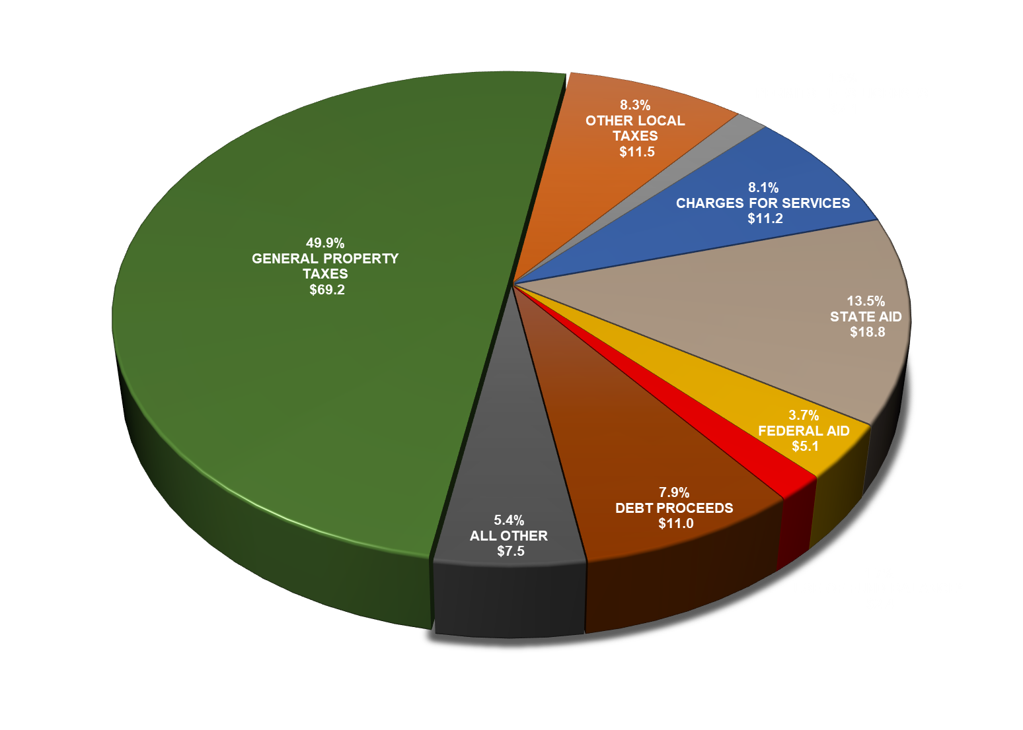
FY2024 Proposed All Funds Revenue Budget ($138.8 million)
* Use of fund balance is primarily proffers and unused CIP funds

Slide 11
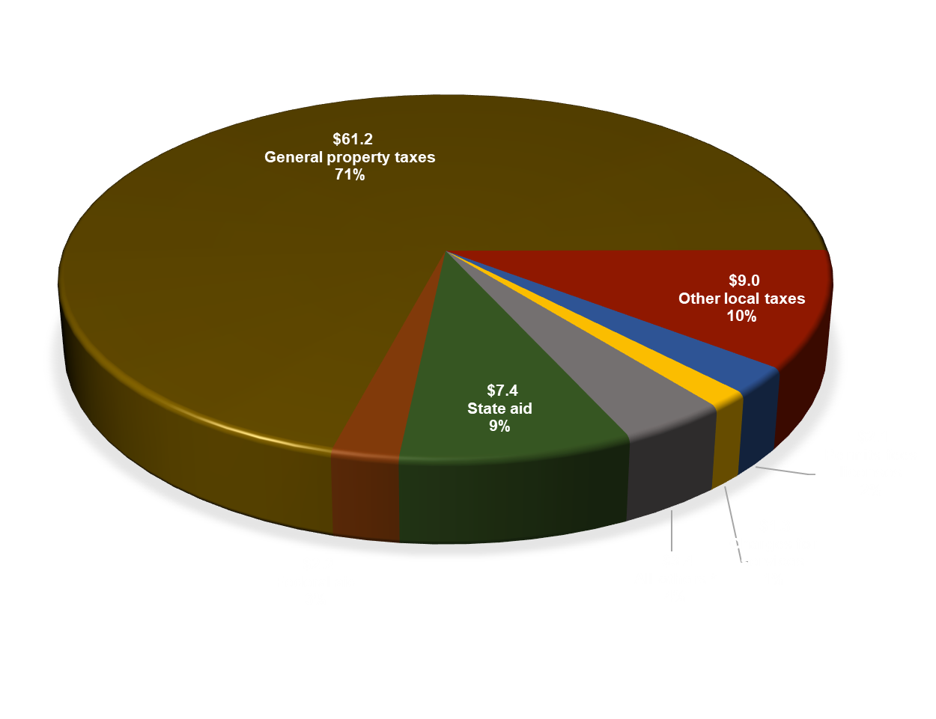
FY2024 Proposed General Fund Revenue ($86.5 million)
* All others includes fines, forfeitures, interest, rent, recovered costs, miscellaneous, and DSS use of prior year fund balance ($500)

Slide 12
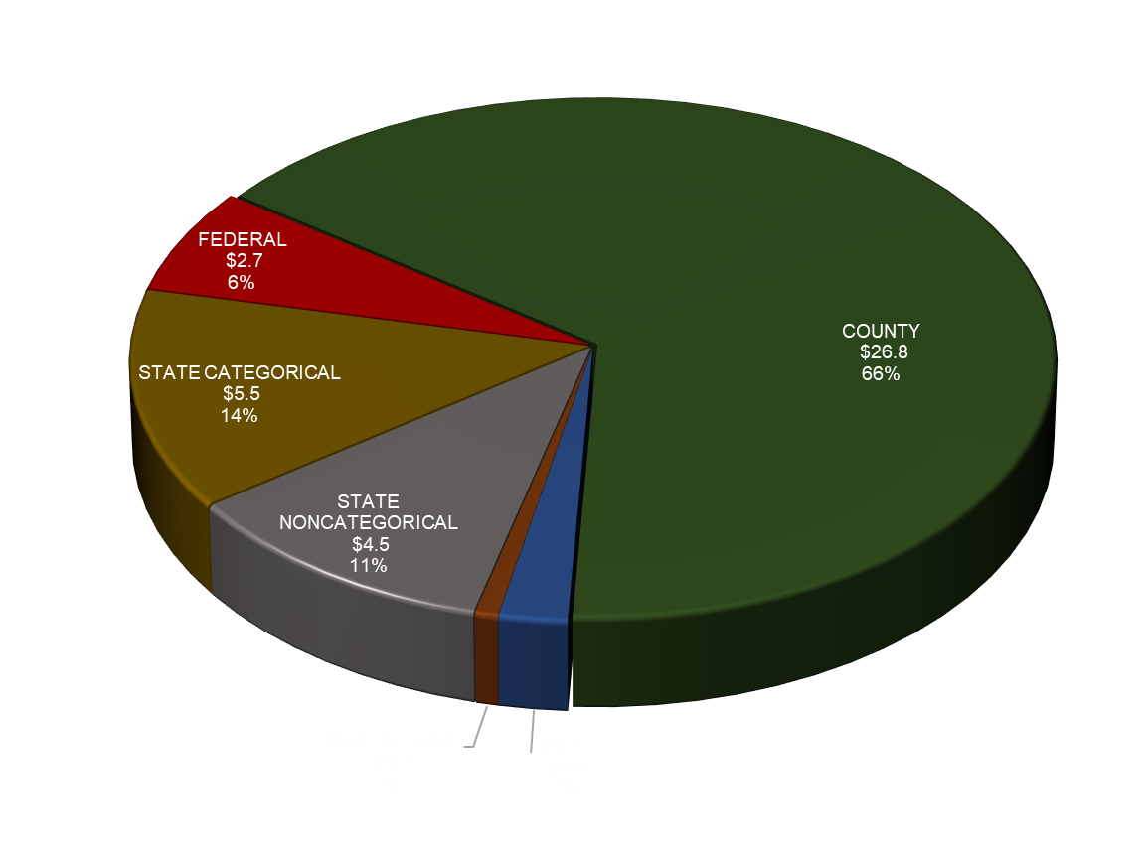
FY2024 Proposed Schools Revenue ($40.7 million)

Slide 13
FY2024 General Fund Revenues By Category

Slide 14
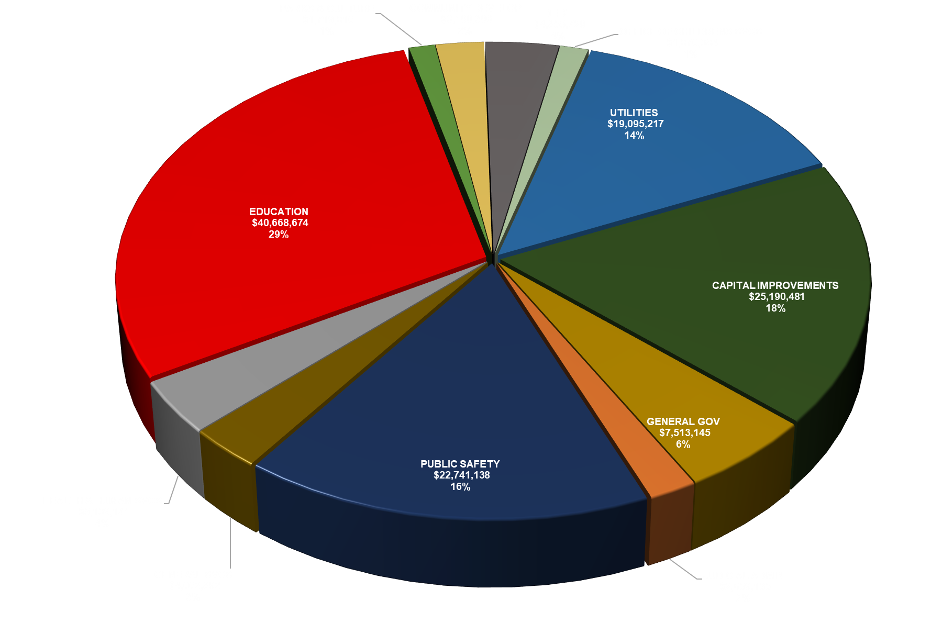
FY2024 Proposed All Funds Expenditure Budget ($138.7 million)

Slide 15
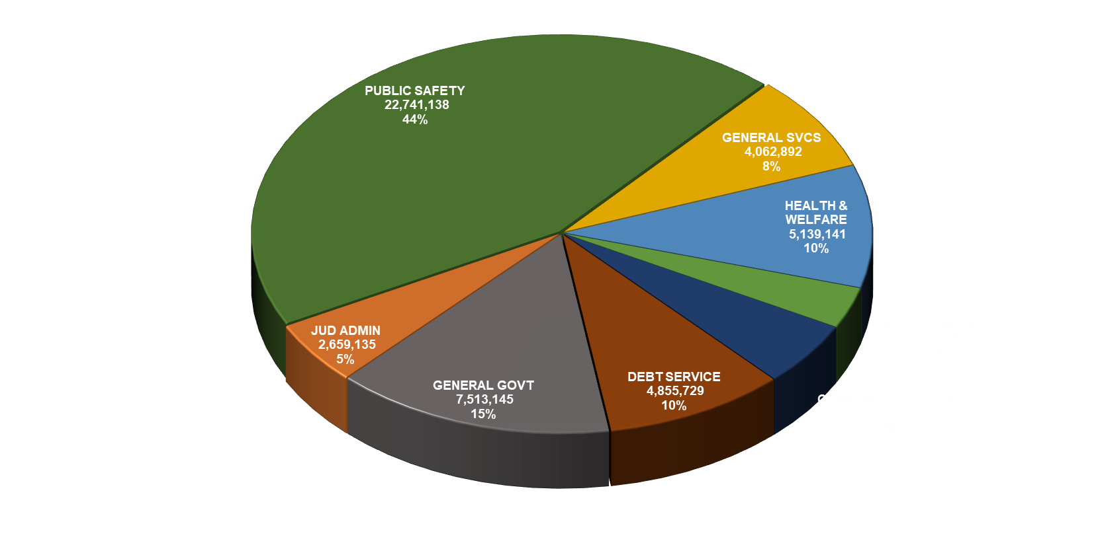
FY2024 Proposed General Fund Operating Expenditures ($51.4 million)
* Does not include OCS, CIP & Schools

Slide 16
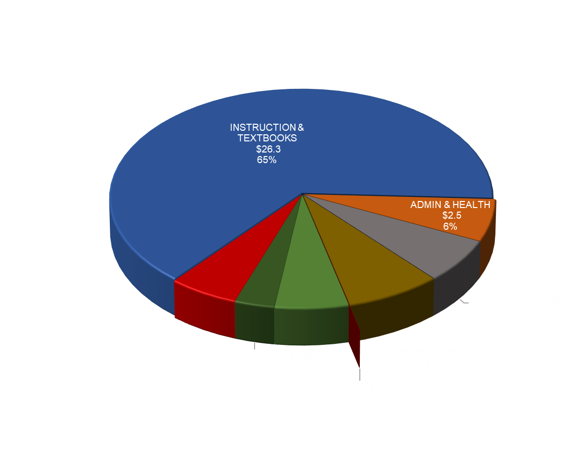
FY2024 Proposed Schools Expense ($40.7 million)
Facilities total is $5,000

Slide 17
BENCHMARK BREAKDOWN BY DEPARTMENT

Slide 18
GENERAL GOVERNMENT
Increases primarily due to the 5% increase in salary and normal benefits increases
Benchmark raises not included in the FY2023 adopted budget at the department level
An 11% increase in health insurance rates

Slide 19
JUDICIAL
Increases primarily due to the 5% increase in salary and normal benefits increases
Benchmark raises not included in the FY2023 adopted budget at the department level
An 11% increase in health insurance rates
General district court does not have employees. The increase is primarily due to increased contracted services
Sheriff court employees received an additional 2% raise in addition to the 5% increase and benchmarking

Slide 20
PUBLIC SAFETY
Increases primarily due to the 5% increase in salary and normal benefits increases
Benchmark raises not included in the FY2023 adopted budget at the department level
An 11% increase in health insurance rates
Due to an exceptionally competitive market, Public Safety employees have raises as follows:
Sheriff employees received an additional 2% raise in addition to the 5% increase and benchmarking
Fire Rescue employees received an additional 2% raise in addition to the 5% increase and benchmarking
Emergency Communications employees received an additional 8% raise in addition to the 5% increase and benchmarking

Slide 21
GENERAL SERVICES
Increases primarily due to the 5% increase in salary and normal benefits increases
Benchmark raises not included in the FY2023 adopted budget at the department level
An 11% increase in health insurance rates
Grounds has a 35% increase in contracted services:
Drop off recycling, used oil filters, used antifreeze, used oil, and category 1 material. Freon removal from refrigerators & freezers. Increase in cost of recycling and increase in volume in all services. Seal driveway at the Western Convenience Center. Overall increase in volume for antifreeze, paint and used oil.
Additional $37,500 for brush mulching.

Slide 22
HEALTH & WELFARE
Contributions include:
FeedMore $6,000
Goochland CASA $8,000
J. Sergeant Reynolds College $38,896
Senior Connections $10,000
Senior Navigator $2,250
DSS increases primarily due to the 5% increase in salary and normal benefits increases
DSS benchmark raises not included in the FY2023 adopted budget at the department level
DSS includes an 11% increase in health insurance rates
Tax relief for the elderly & veterans is receiving an additional $100,000 due to trend of actual relief in prior years. No other changes made to the program.

Slide 23
PARKS, REC & CULTURAL
Increases primarily due to the 5% increase in salary and normal benefits increases
Benchmark raises not included in the FY2023 adopted budget at the department level
An 11% increase in health insurance rates
The Parks & Rec increase in salary & benefits were partially offset by shifting costs to other departments

Slide 24
COMMUNITY DEVELOPMENT
Increases primarily due to the 5% increase in salary and normal benefits increases
Benchmark raises not included in the FY2023 adopted budget at the department level
An 11% increase in health insurance rates
In addition to the above, Community Development has a substantial increase in salaries & benefits due to reorganizing employees
Planning shows a slight increase; they have a $150,000 increase in professional services offset by a decrease in salaries & benefits due to reorganizing employees
Environmental & EDA decrease is due to reorganizing employees
Notes:
CD increase in S&B = $355,103
Planning down = (173,446)
Environmental = (91,022)
Economic Dev = (35,522) – due to taking out portion of Deputy County Admin from department

Slide 25
UTILITIES
Revenues include increase in rates to follow rate study:
Water increase 3%
Sewer increase 4%
Connection fees increase 5.5%
Increase in operating exp. is primarily due to the 5% increase in salary, normal benefits increases, and an 11% increase in health insurance rates
CIP exp. is showing a decrease due to no additional projects starting this year – exp. include debt service and a $1.8 million contribution to fund balance
TCSD is increasing for debt payment

Slide 26
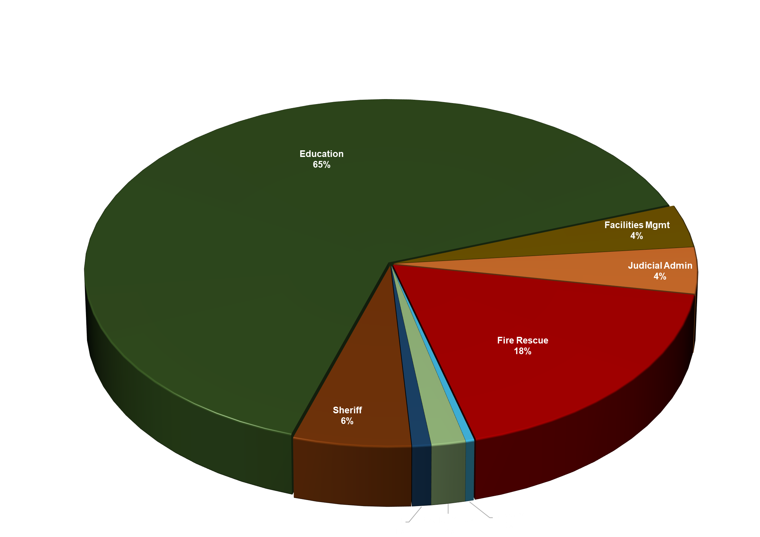
FY2024 25-Year Capital Improvement Plan (CIP) ($612.5 million)

Slide 27
Summary of FY2024 Budget Accomplishments
Continues to meet or exceed all financial policies
Includes 5% cost of living salary increases for County employees and market comparison increases
Public safety remains a priority – 9 new positions funded, additional 2% salary increase for all sheriff and fire-rescue personnel, additional 8% salary increase for all communications personnel
Education remains a priority - $1.25 million increase in local contribution, $19 million in school CIP projects including $15,000,000 for Goochland Elementary School.
Includes funding for necessary studies for upcoming projects for the community
No increase in real estate tax rate, TCSD tax rate, or personal property tax rate
Includes 100% tax relief for all personal vehicles valued up to $5,000, saving citizens from paying personal property taxes on approximately 9,000 vehicles

Slide 28
Budget Schedule
February 21, 2023: County Administrator, Sheriff, Fire/EMS, Authorize Tax Rate
March 8, 2023: District 4 & 5 Townhall, Residence Inn at the Notch, 6:30 to 8:30 PM
March 14, 2023: County CIP FY2024-FY2048 Work Session
March 23, 2023: District 1 Townhall, Byrd Elementary, 6:30 to 8:30 PM
March 30, 2023: District 2 & 3, Central Educational & Cultural Center, 6:30 to 8:30 PM

Slide 29
Budget Schedule
April 4, 2023: Beginning at 6:00 pm
Tax Rate Public Hearing followed by,
TCSD Ad Valorem Rate Public Hearing followed by,
FY2024 Budget and Related Items Public Hearing
April 18, 2023: 2:00 pm
Budget Adoption

Slide 30
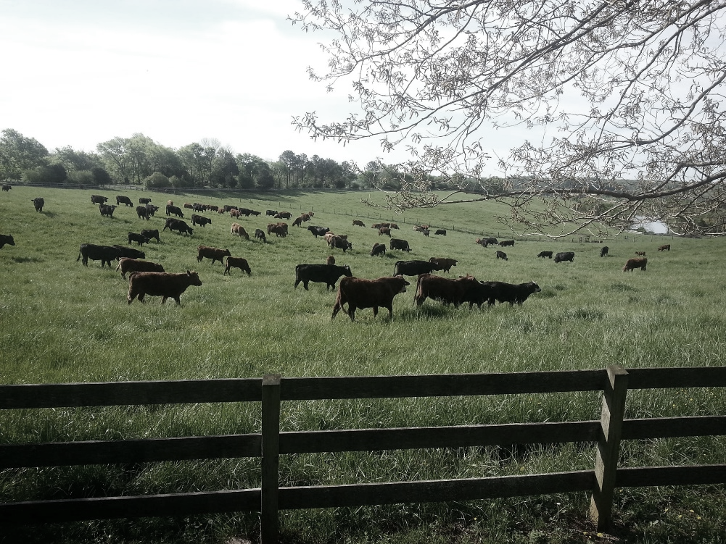
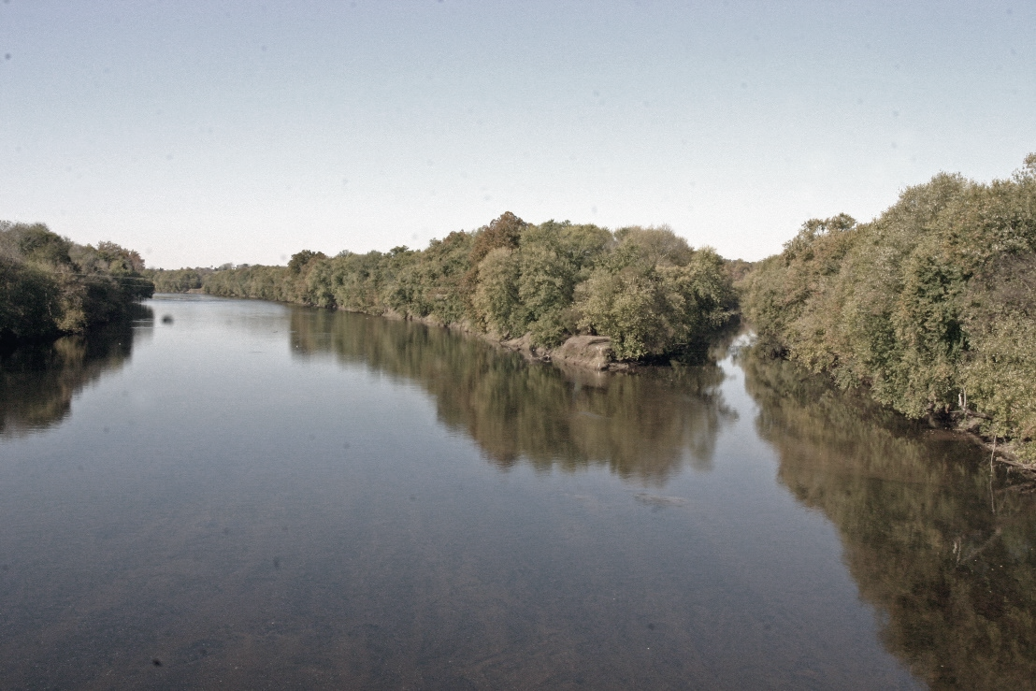

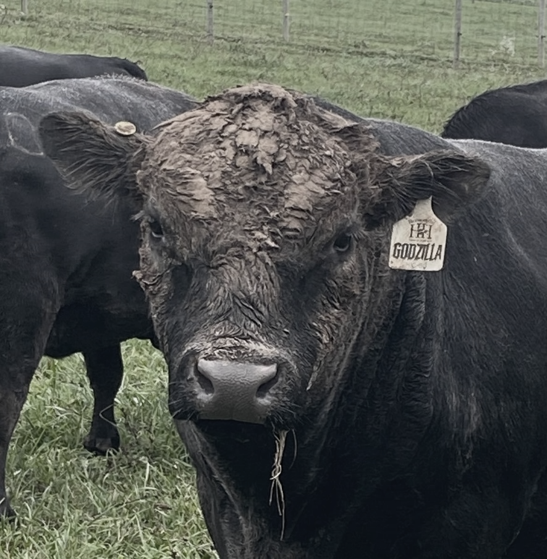
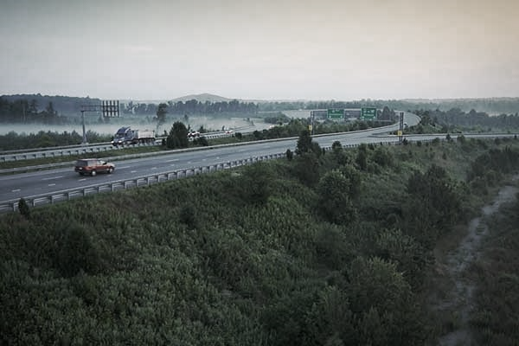
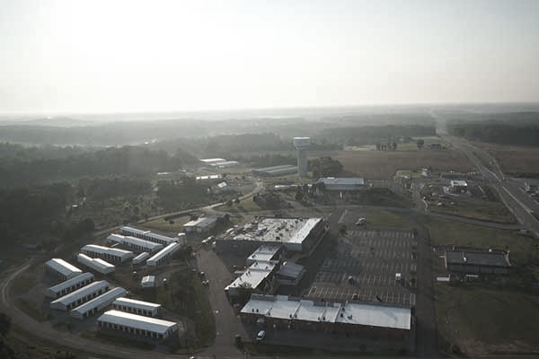
Questions?

Slide 31
BOARD OF SUPERVISORS

Slide 32
COUNTY ADMINISTRATOR

Slide 33
COMMUNITY ENGAGEMENT

Slide 34
COUNTY ATTORNEY

Slide 35
HUMAN RESOURCES

Slide 36
COMMISSIONER OF REVENUE

Slide 37
COUNTY ASSESSOR

Slide 38
TREASURER

Slide 39
FINANCE

Slide 40
PURCHASING

Slide 41
INFORMATION SYSTEMS

Slide 42
REGISTRAR

Slide 43
NONDEPARTMENTAL

Slide 44
CIRCUIT COURT

Slide 45
GENERAL DISTRICT COURT

Slide 46
CLERK OF THE CIRCUIT COURT

Slide 47
SHERIFF COURT RELATED

Slide 48
COMMONWEALTH ATTORNEY

Slide 49
SHERIFF Page 1

Slide 50
SHERIFF Page 2

Slide 51
SCHOOL RESOURCE OFFICER

Slide 52
FIRE & RESCUE Page 1

Slide 53
FIRE & RESCUE Page 2

Slide 54
EMERGENCY PLANNING FIRE GRANT

Slide 55
CORRECTION DETENTION TRAINING

Slide 56
BUILDING INSPECTIONS

Slide 57
ANIMAL PROTECTION Page 1

Slide 58
ANIMAL PROTECTION Page 2

Slide 59
EMERGENCY COMMUNICATIONS

Slide 60
SHERIFF GRANTS

Slide 61
EMERGENCY TECHNOLOGY

Slide 62
VIRGINIA JUVENILE COMMUNITY CRIME CONTROL

Slide 63
CONVENIENCE CENTER

Slide 64
GENERAL SERVICE Page 1

Slide 65
GENERAL SERVICE Page 2

Slide 66
GROUNDS MANAGEMENT

Slide 67
HEALTH & WELFARE

Slide 68
DEPARTMENT OF SOCIAL SERVICES

Slide 69
PARKS & RECREATION Page 1

Slide 70
PARKS & RECREATION Page 2

Slide 71
PAMUNKEY REGIONAL LIBRARY

Slide 72
COMMUNITY DEVELOPMENT

Slide 73
PLANNING

Slide 74
ENVIRONMENTAL

Slide 75
ECONOMIC DEVELOPMENT

Slide 76
PAYMENTS TO EDA

Slide 77
VPI EXTENSION PROGRAM

Slide 78
DEBT SERVICE

Slide 79
TRANSFER TO OTHER FUNDS

Slide 80
UTILITIES OPERATING

Slide 81
UTILITIES OPERATING Page 2

Slide 82
UTILITIES OPERATING Page 3

Slide 83
UTILITIES CIP

Slide 84
UTILITIES TCSD

Slide 85
UTILITIES EGPS

