Slide 1

Fire-Rescue and Emergency Services Opticom Traffic Preemption System
Board of Supervisors
February 2021

Slide 2

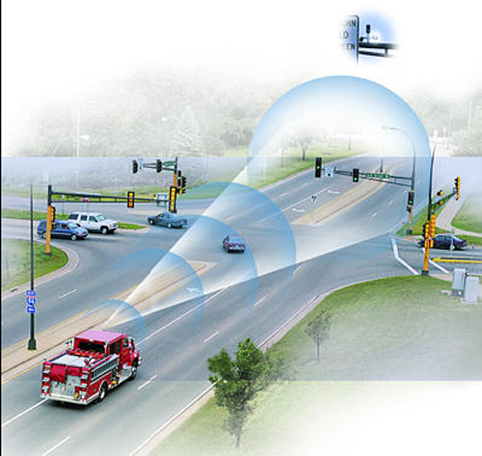

Slide 3
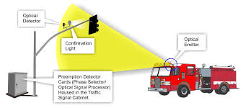

Slide 4
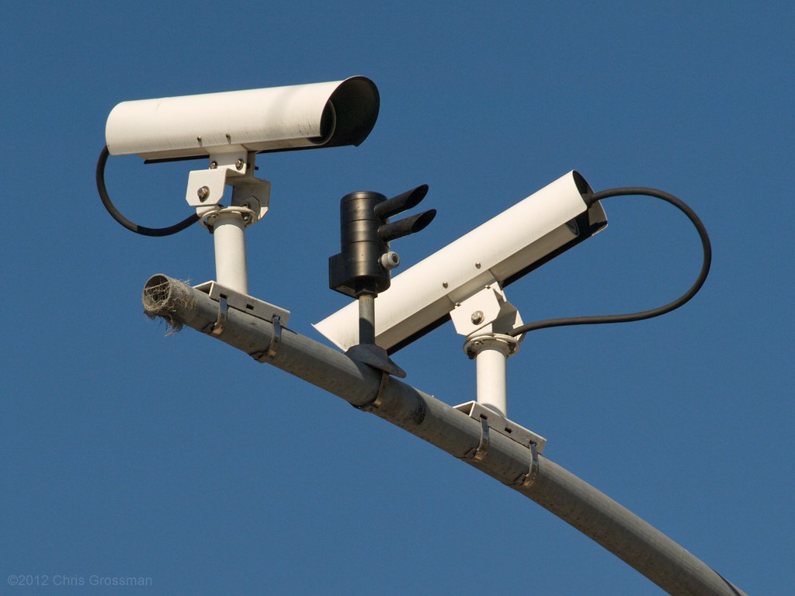

Slide 5
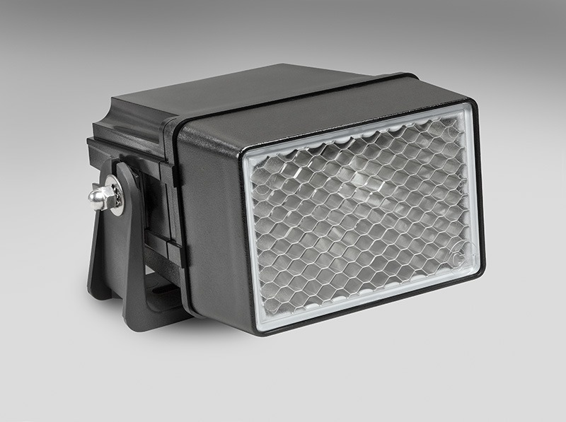

Slide 6
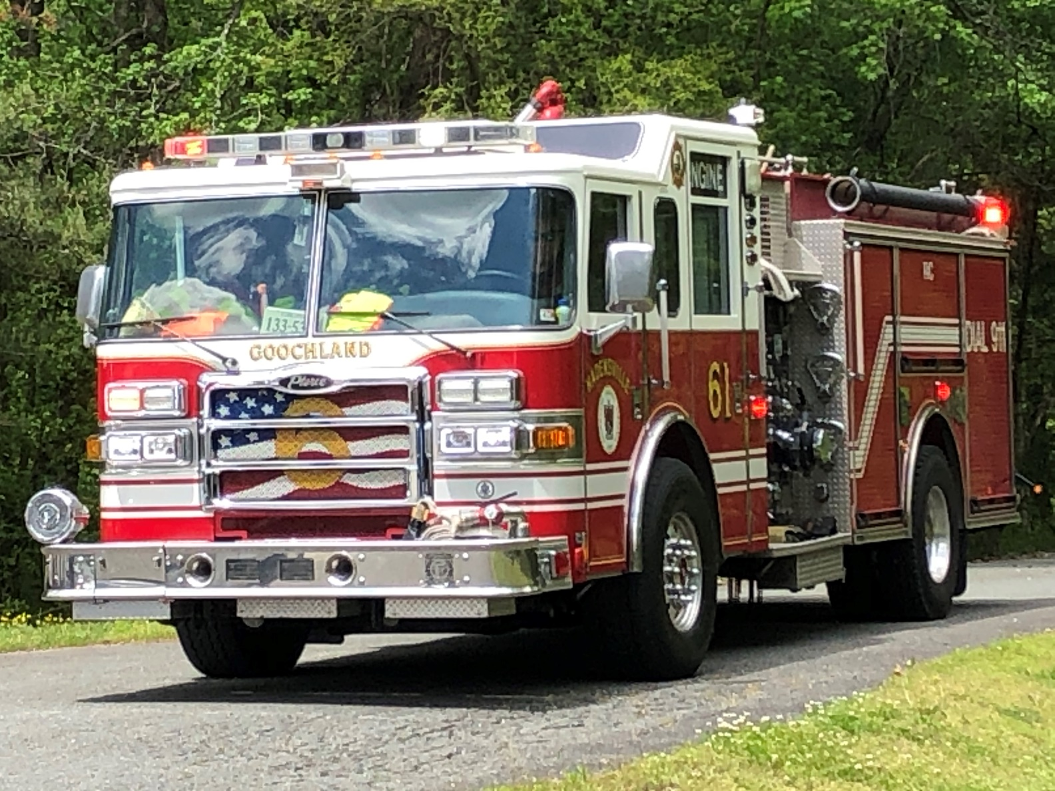

Slide 7
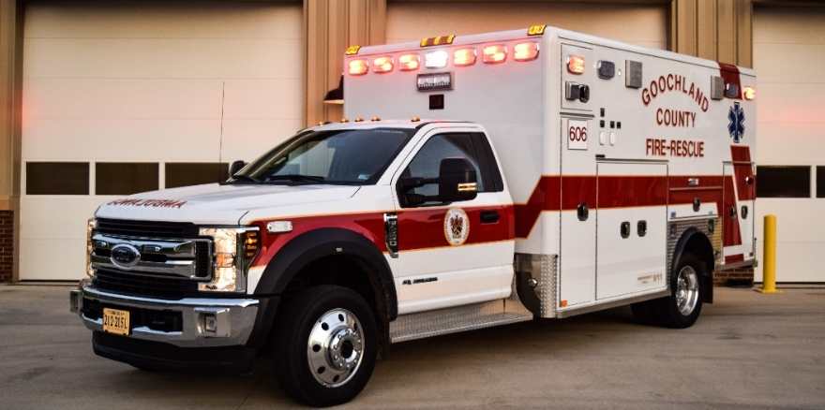

Slide 8
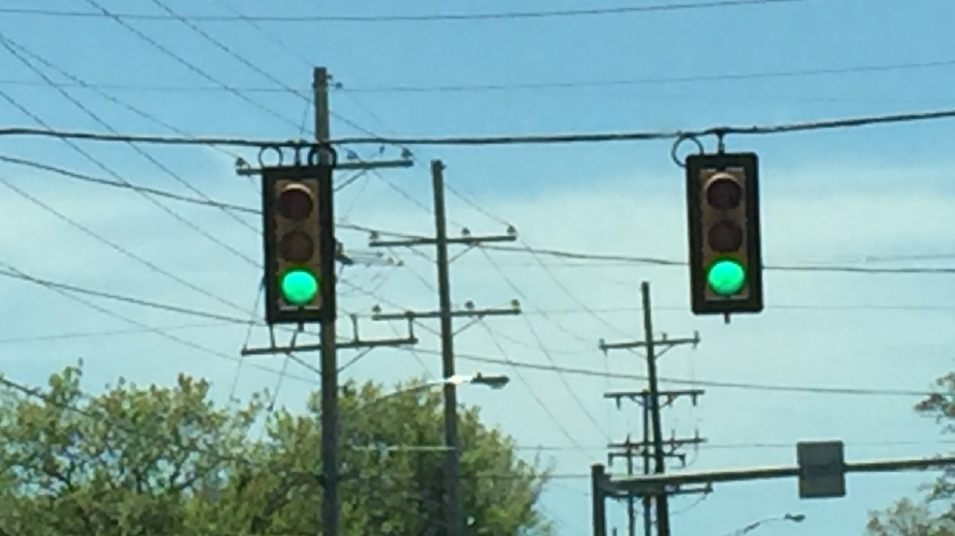

Slide 9
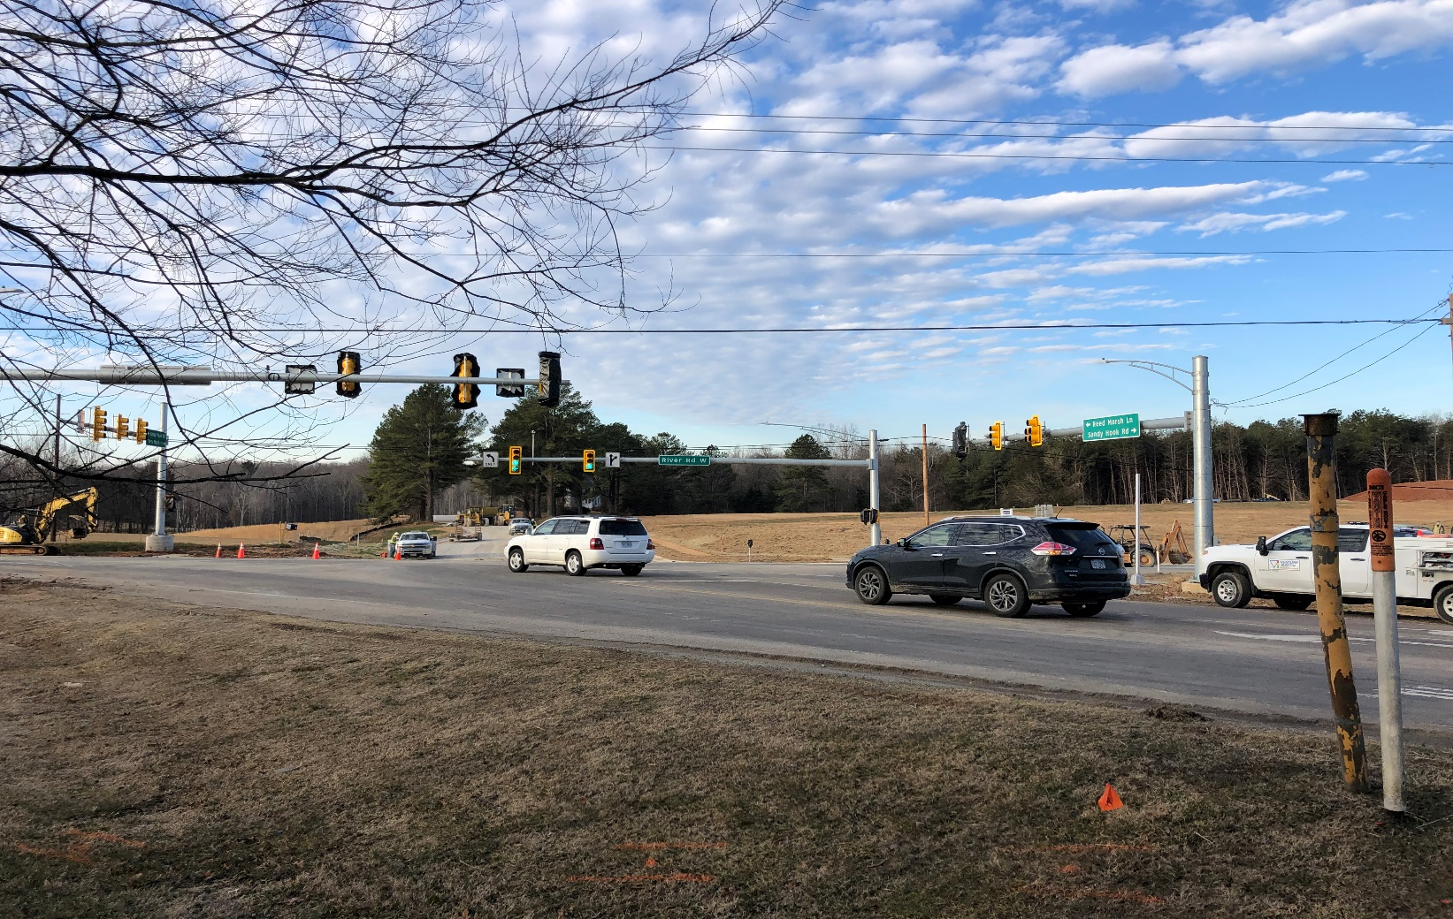

Slide 10
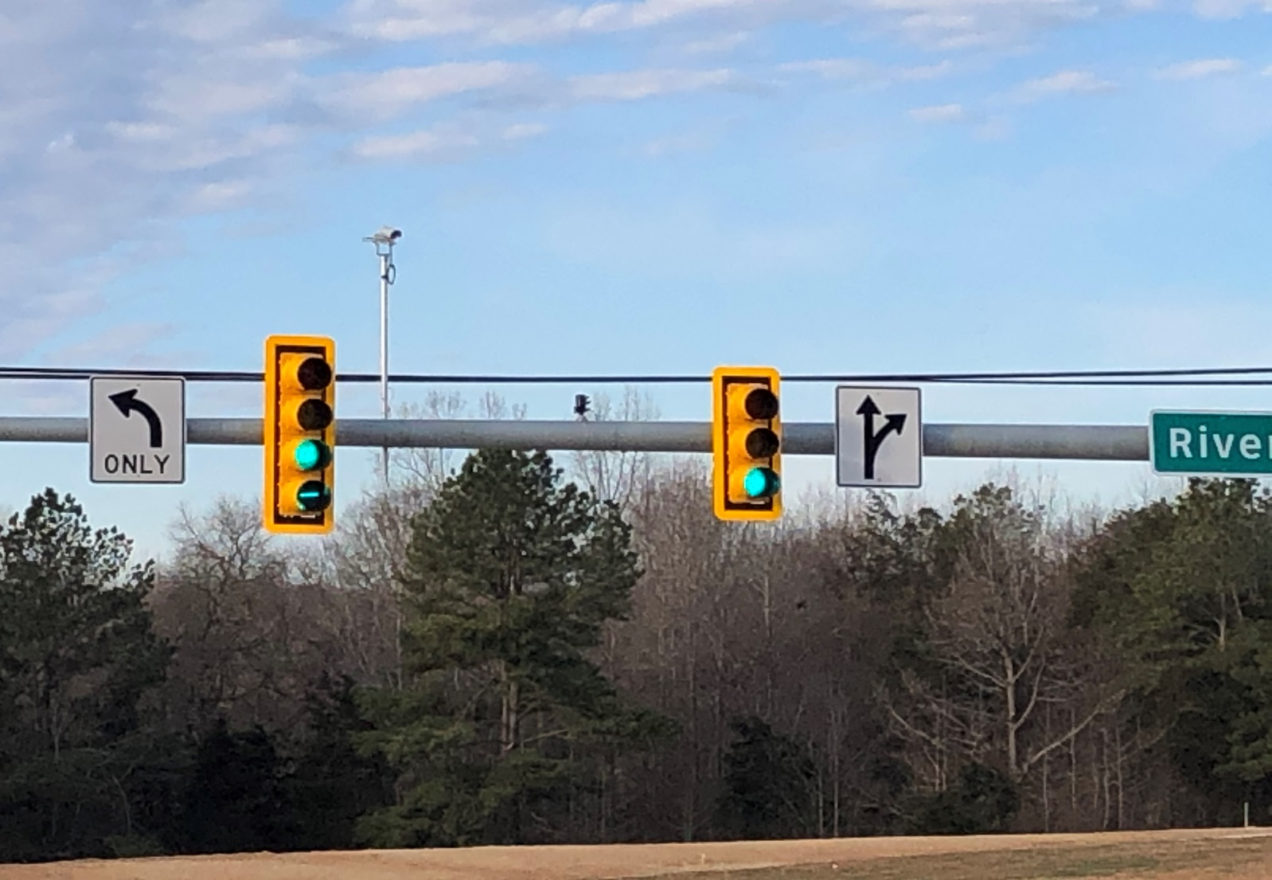

Slide 11
Goochland County Traffic Signals 02-2021
Signals with Opti Com :
Tuckahoe Creek PKWY & Capital One Drive
Manakin Rd. & Broad St. Rd.
River Rd W. & Sandy Hook Rd.
Broad St. Rd at Company 3
Ashland Rd. & I64 interchange
Signals without Opti Com:
Patterson Ave & West Creek Pkwy (Hope Church)
Blair Rd. & Patterson Ave
Wilkes Ridge Dr. & Broad St. Rd.
Broad St. Rd. & Four Rings Dr. (Drive Shack)
288 & Broad St. Rd.
Ashland & Broad St. Rd.
Hockett & Broad St. Rd.
Oilville Rd. & Broad St. Rd.
River Rd. W. & Maidens

